Slide 1
Test Report
Test framework:
RSpec is testing tool for the Ruby programming language. Born under the banner of Behaviour-Driven Development, it is designed to make Test-Driven Development a productive and enjoyable experience
Test Driver :
Capybara helps you test web applications by simulating how a real user would interact with your app. ( simulating browser event).
Mocks:
FactoryGirl : create mocks for database ( model)

Slide 2
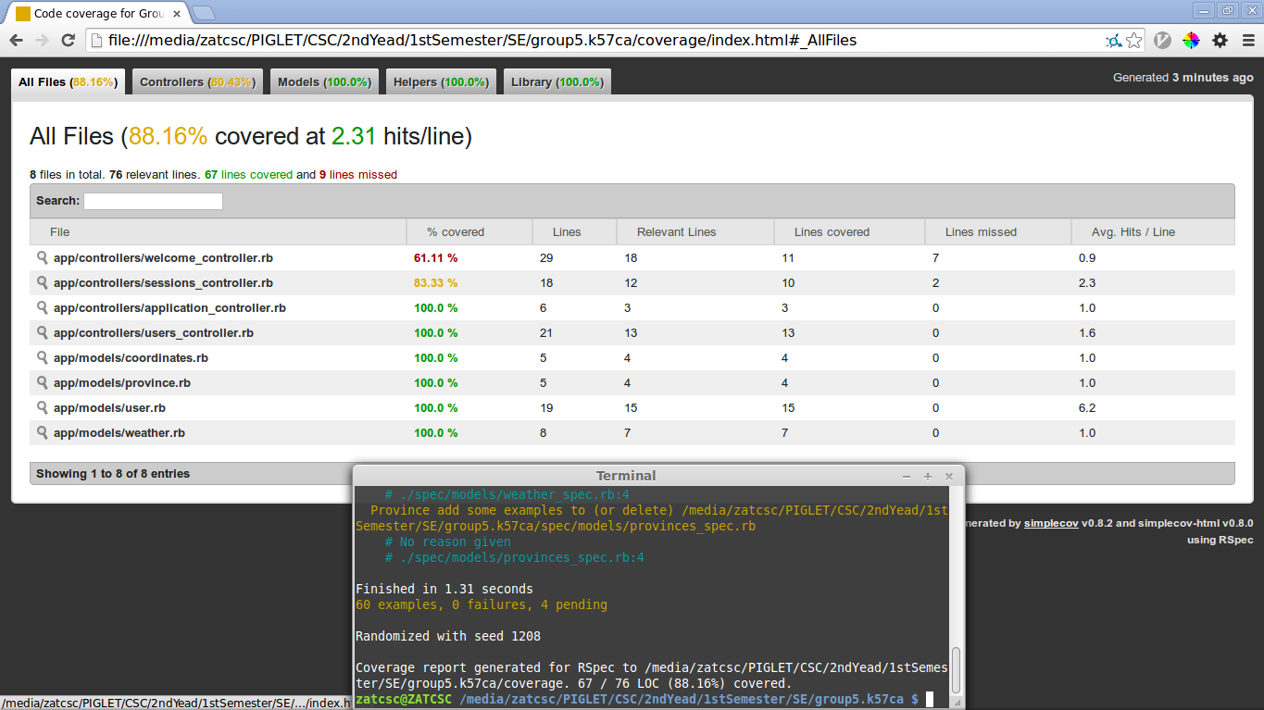

Slide 3
Overview
Number of Tests: 60 examples
Test Coverage: overal 88.16 %
Test includes
  Model Test
  Request Test
  View Test

Slide 5
Model Test::User
Users model Test (spec/model/user_spec.rb)
User spec covers following aspecs of Users model
  User model should have properties:
    name
    email
    password_digest
    password
    password_confirmation
    remember_token
Example Code:
it {should respond_to(:name)}
it {should respond_to(:email)}
it {should respond_to(:password_digest)}
it {should respond_to(:password)}
it {should respond_to(:password_confirmation)}
it {should respond_to(:remember_token)}
it {should respond_to(:authenticate)}

Slide 6
Model Test::User
A User should have a method to authenticate if a user with given email and password do existed in database or not .
  Method: authenticate
Example Code:
describe "return value of authenticate method" do
before {@user.save}
let(:found_user) {User.find_by(email: @user.email)}
describe "with valid password" do
it {should eq found_user.authenticate(@user.password)}
end
describe "with valid password" do
let(:user_for_invalid_password) { found_user.authenticate("invalid") }
specify {expect(user_for_invalid_password).to be_false}
end
end

Slide 7
Model Test::User
A User should not be valid when:
  name is blank
  name has less than 6 characters
  email is blank
  email is not right form
  password is blank
A User should be created when all above fields are valid
Example Code:
describe "when email format is invalid" doode
it "should not be valid" do
addresses=%w[user@foo,com user_at_foo.org example.user@foo.
foo@bar_baz.com foo@bar+baz.com]
addresses.each do |invalid_address|
@user.email=invalid_address
expect(@user).should_not be_valid
end
end
End
(find more in spec/requests)

Slide 8
Model Test::User
A User should have a method to authenticate if a user with given email and password do existed in database or not .
  Method: authenticate
Example Code:
describe "return value of authenticate method" do
before {@user.save}
let(:found_user) {User.find_by(email: @user.email)}
describe "with valid password" do
it {should eq found_user.authenticate(@user.password)}
end
describe "with valid password" do
let(:user_for_invalid_password) { found_user.authenticate("invalid") }
specify {expect(user_for_invalid_password).to be_false}
end
end

Slide 9
Model Test::Coordinates
Coordinates is a model to save a coordinate in a map
A Coordinates should have following properties
  Longitude
  Lattitude
Example Code:
it {should respond_to(:logitude)}
it {should respond_to(:latitude)}

Slide 10
Model Test::Coordinates
A Coordinates is valid when its properties are in range:
  -180 <= longitude <=180
  -90 <= latitude <= 90
Example Code:
describe "when the coordinates is out of range" do
describe "with logitude is less than -180" do
before { @example.logitude=-200 }
it {should_not be_valid}
end
describe "with logitude is greater than 180" do
before { @example.logitude = 200}
it {should_not be_valid}
end
end

Slide 11
Model Test::Coordinates
A Coordinates is valid when its properties are in range:
  -180 <= longitude <=180
  -90 <= latitude <= 90
Example Code:
describe "when the coordinates is out of range" do
describe "with logitude is less than -180" do
before { @example.logitude=-200 }
it {should_not be_valid}
end
describe "with logitude is greater than 180" do
before { @example.logitude = 200}
it {should_not be_valid}
end
end

Slide 12
Model Test::Weather
A Weather is used to store weather infomation in a place in a specific day of week
A Weather model “must” have following properties
  Day
  Curent date
  Min_temperature
  Max_temperature
Example Code:
it {should respond_to(:day)}
it {should respond_to(:current_date)}
it {should respond_to(:min_temperature)}
it {should respond_to(:max_temperature)}

Slide 13
Model Test::Weather
Test for the presense and validation of Weather model's properties.
Example Code:
describe "when day is valid" do
before {@example.day = "Mon"}
it {should be_valid}
end
describe "when min_temperature is not valid" do
before {@example.min_temperature = -50}
it {should_not be_valid}
end

Slide 14
ViewTest::Sign in
When visit Sign In Page, it should have:
  Right title “Sign In”
  Right header “Sign in”
  Have email box and label
  Have password box and label
  Have submit b
Example code:
before {visit signin_path}
it {should have_content("Sign in")}
it {should have_title("Sign in")} ...

Slide 15
ViewTest::Sign up
Test view for Sign up and some other page such as : contact page, about page is similar with “sign in” page. So that we just mention the idea to avoid the duplication. For more details, please see “spec/request” in project folder.

Slide 16
TestRequest::Sign in
When user type in the correct email and password →Broswer should redirect to Home page with links to profile page, sign out
Example Code:
describe "with valid information" do
let(:user) { FactoryGirl.create(:user) }
before do
fill_in "Email", :with => user.email
fill_in "Password", :with => user.password
click_button "Sign in"
end
it {should have_link("Profile", href: user_path(user))}
it {should have_link("Sign out", href: signout_path)}
it {should_not have_link("Sign in",href: signin_path)}
end

Slide 17
TestRequest::Sign in
When user type in incorrect email and password → Broswer should not redirect to other page and show error messsage
Example Code:
describe "with invalid information" do
before { click_button "Sign in" }
it { should have_title('Sign in') }
it { should have_selector('div.error') }
describe "after visiting another page" do
before { click_link "About" }
it { should_not have_selector('div.error_explanation') }
end
end

Slide 18
TestRequest::Sign up
When user type in with valid information. Server should create a new account and redirect user to profile page
And if with invalid information. Server should not create a new account and the number of user account doesn't change
Example Code:
describe "with invalid information" do
it "should not create a user" do
expect{click_button submit}.not_to change(User,:count)
end
end
describe "with valid information" do
it "should create a user" do
fill_in "Name", with: "Nguyen Thac Thong"
fill_in "Email", with: "nguyenthacthong1@gmail.com"
fill_in "Password", with: "1234567"
fill_in "Password confirmation", with: "1234567"
expect{click_button submit}.to change(User,:count).by(1)
end
end

